Slide 1
Suresh Babu
PNG Policy Dialogue Presentation
September 10, 2018
Understanding Policy Process in Developing Countries: Case Studies and Lessons

Slide 2
Organization of Presentation
Why Study Policy Process?
A Model of Policy Process
Lessons from Role of Networks in Policy Process
Applications to Extension and Policy Communications
Concluding Remarks

Slide 3
Why study the Policy Process?
What drives the process of policy making and implementation under various political and socioeconomic contexts in various countries?
What are the challenges to design implement policies or enacting the laws?
How could be the process of policy change be enhanced?
What specific interventions will help in building better capacity of the policy system at its actors and players?
What innovations are need to track the improvements in the policy process?
What lessons could be learned from the case studies form developing countries?

Slide 4
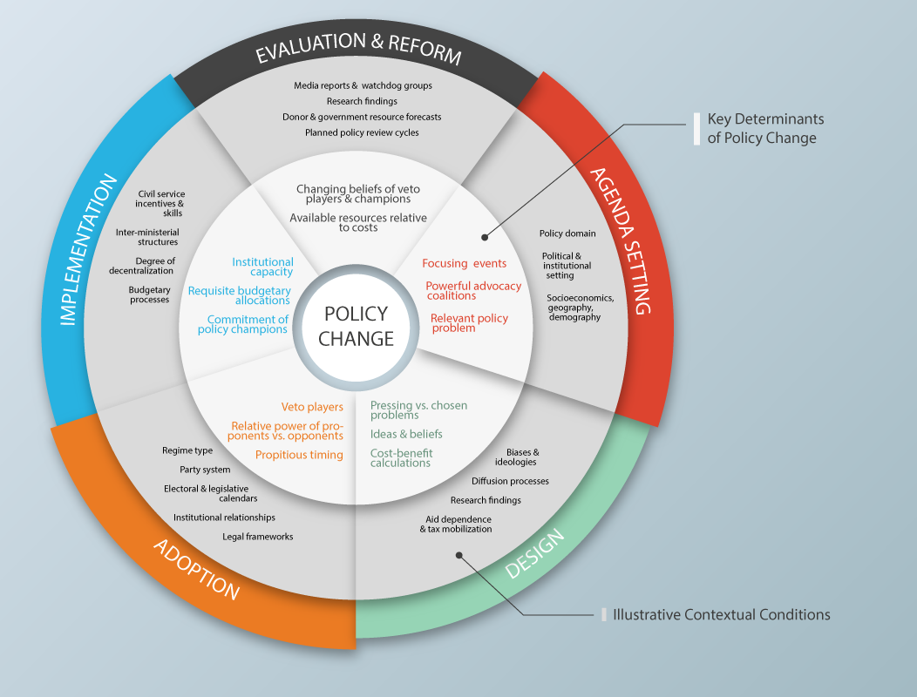
A Model of Policy Process
Source: Resnick et al (2014) – Draft Conceptual Framework paper under review

Slide 5
Integrating Disparate Literatures
  Public and policy administration approaches
    Policy stage heuristics
    Multiple streams
    Advocacy coalitions
    Diffusion models
    Principal-agent models
  Political economy approaches
    State vs. society-centered drivers of change
    Rationalist, institutionalist, and constructivist theories
    Source: Resnick et al (2014) – Draft Conceptual Framework paper under review

Slide 6
Identifying Key Variables
Opportunity structures
Timing
Regime type
Ideas
Previous history
Epistemic communities
Diffusion of models
High level commitments
Leaders’ ideologies
Interests
Affected stakeholders’ interests
Bureaucratic preferences
Party/regime legitimacy and selectorate
Donor preferences
Institutions
Parliamentary vs. presidential structure
Party systems
Bureaucratic organization and capacity
Affected stakeholders’ organization
Degree of decentralization
Source: Resnick et al (2014) – Draft Conceptual Framework paper under review
Nature of the policy
(redistributive, distributive, regulatory, etc.)
Stages of Policy Process
Agenda-setting
Design
Adoption
Scale of policy change
(major policy innovation or gradual refinement)
Implementation
Evaluation

Slide 7
Lessons from Bangladesh
BRAC – largest NGO in Bangladesh
CSOs raised voices about the concerns
Government concerned about the political instability
Convened consultations of the CSOs
BIDS conducted research and analysis
FPMU – Ministry of Food coordinated consultations – Training in analysis of causes of interventions
Recommended social protection measures emphasizing long term development
Source: IFPRI-BRAC consultations in 2009, Dhaka

Slide 8
Lessons from India
(Source: Consultations by IFPRI in 2009, New Delhi)
Food Security Bill of 2013
Began with a law suit by a lawyer at the Supreme Court
Mobilization of the NGOs behind the “Right to Food”
Researchers and CSOs collaborated with their strengths to bring research and outreach together
Policy system took this up and debated for several years
CSOs brought ground level reality to the policy debates on a regular basis

Slide 9
Lessons from Vietnam
(Source: Consultations by IFPRI in 2011, Hanoi)
Climate change policies and programs
Several ministries and agencies are involved
Initially doubts about the knowledge and role of NGOs in the Climate change issues
Leading NGO activist organization mobilized other CSOs for consultation
Several rounds of training and capacity development were organized
CSOs are beginning to help in the process of local consultation and dissemination of information about the potential challenges and adaptation measures.

Slide 10
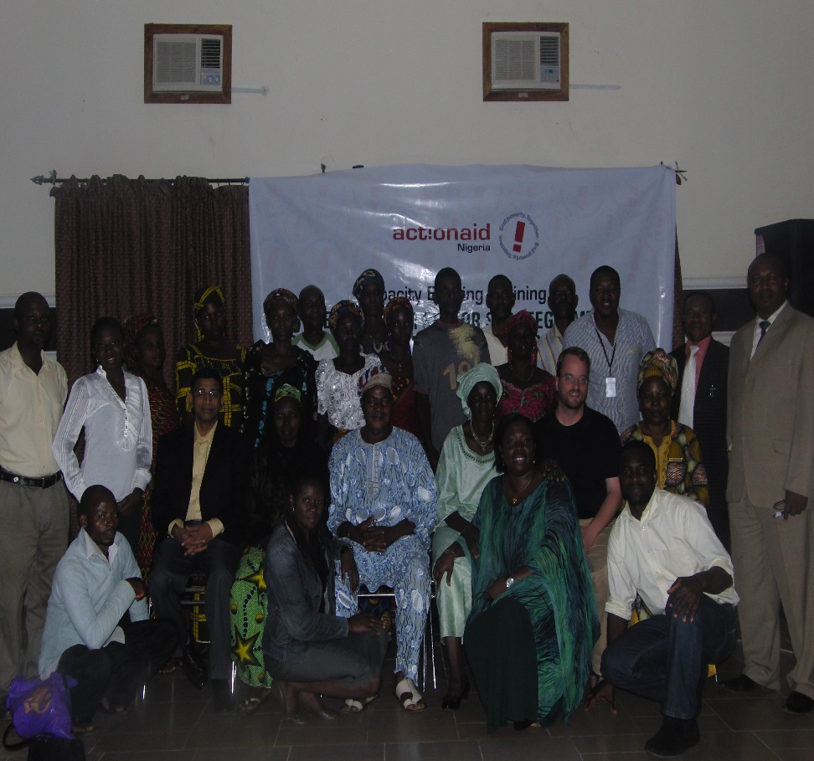
Lessons from Nigeria
Source: Babu et al (2014)
Coalition of food security NGOs
Very little attention or consultation until 2007-08 food crisis
Activism during the crisis help to bring the members together
Action Aid – capacity strengthening of the members
Better demand for intervention programs and delivery of services

Slide 11
Thematic Application:
Tools and Applications to Policy and Extension Communications
Setting extension policy priorities
Mapping extension policy system
Developing policy chronology fro extension
Institutional Architecture Analysis
Stakeholder mapping – Application to ATMA
Assessing the needs for extension communication
Developing policy communication strategies
All the above tools will be developed as part of the group exercise by the participants

Slide 12
Issues in the context of Nepal Agriculture
Private sector can play effective role in the agricultural growth process along with cooperatives and public sector
Private sector can play an important role in the input delivery, pluralistic extension system, and in the processing and marketing of the produces
Private sector programs for value chains are effective, but their coverage is limited
Creating private sector friendly policy environment requires consultations and dialogues throughout the policy process?
Public-private partnerships can increase the efficiency and effectiveness of the public policy design and implementation – PPDs can play a key role
Need better understanding of costs and benefits of involvement of private sector or otherwise

Slide 13
Conclusions
Role of Private sector in the policy process needs to be identified and encouraged
Need to monitor nature of policy environment – are they private sector friendly
How PPDs can help in dispute resolution and speeding up the private sector role
How to avoid the risks that come with Private sector participation in policy process?
The scale (and scope) of private sector depend on their inclusion in policy making and implementation

Slide 14
Concluding Remarks
Addressing the issues, constraints and challenges of policy makers and stakeholders in a policy system – NGOs, networks play a key role
Translating research and evidence into effective agriculture, Food security and nutrition policies – synthesis of research and consultation of the evidence is a comparative advantage of the networks
In the context of policy change, improving capacity of the Network members in policy advocacy and communication based on available evidence through strategic analysis and synthesis could be effective

